Slide 1
Member Referral Program

Slide 2
UNITED WE BREW™
You know
The value of your Master Brewers membership
Other people in the brewing industry
Notes:
As a Master Brewers member, you'll receive access to educational resources, peer advice in forums, courses on issues including brewery packaging and brewing and malting science, free webinars and podcasts on trending topics, the Technical Quarterly, and more. Membership helps you gain access to resources, insights, and a global network to help you brew the best beer. Our member referral program is an opportunity for you to share your passion for brewing excellence with colleagues who might not be aware of everything master Brewers has to offer.

Slide 3
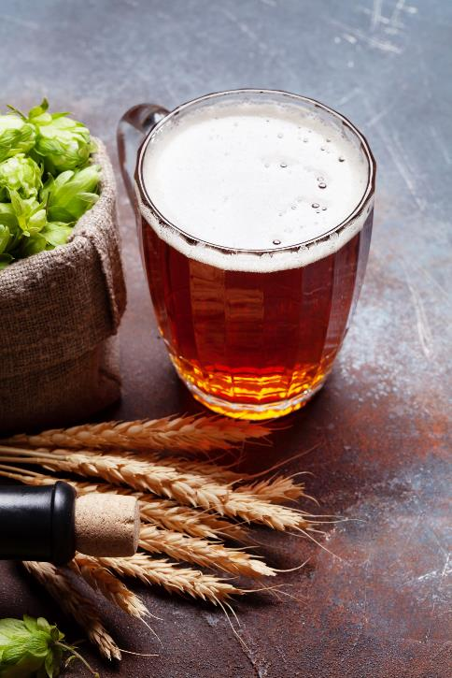
Member Referral Program
Share Master Brewers with your peers & earn a discount on your membership dues when they join!
Receive 20% discount on your membership for each new member you get to join
Refer 5 new members, and your dues at renewal are free
Notes:
Maximum discount of 100% (for up to 5 new member referrals) applies only to Professional Membership dues. An additional incentive will be awarded for anyone that receives more than 5 new member referrals. District dues are exempt from this offer. Applicants must be first-time Master Brewers members for you to receive a 20% discount. Discounts will not be awarded for lapsed or renewing members.

Slide 4
Getting Rewarded is Simple
Tell nonmembers about Master Brewers value
Share the 20% discount code NewBrew23 for them to use on membership dues
Recommend they list your name as the “referring Member” on their application
MBAA HQ will track your referrals and automatically discount your dues
Notes:
Maximum discount of 100% (for up to 5 new member referrals) applies only to Professional Membership dues. An additional incentive will be awarded for anyone that receives more than 5 new member referrals. District dues are exempt from this offer. Applicants must be first-time Master Brewers members for you to receive a 20% discount. Discounts will not be awarded for lapsed or renewing members.

Slide 5
UNITED WE BREWTM

